Slide 1
New Drug Delivery Systems
Kimberly K. Scarsi, PharmD, MSc
Associate Professor
College of Pharmacy
University of Nebraska Medical Center
I have no conflicts of interest related to this presentation.

Slide 2
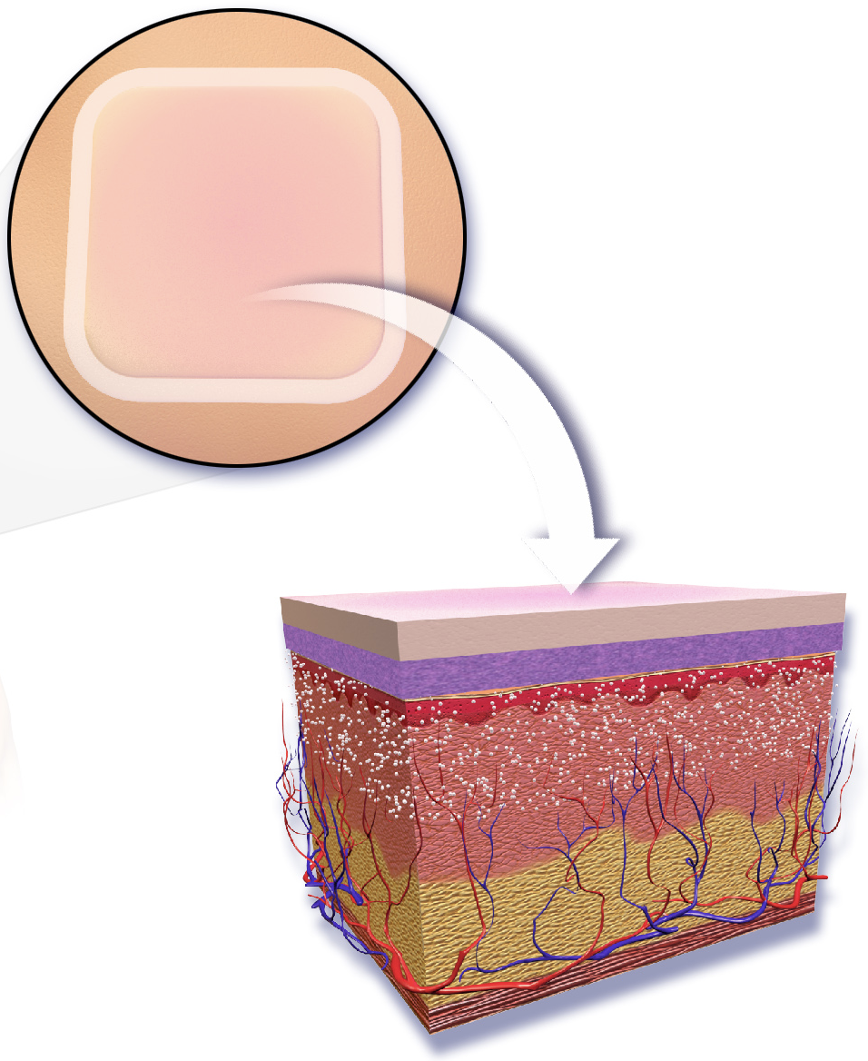
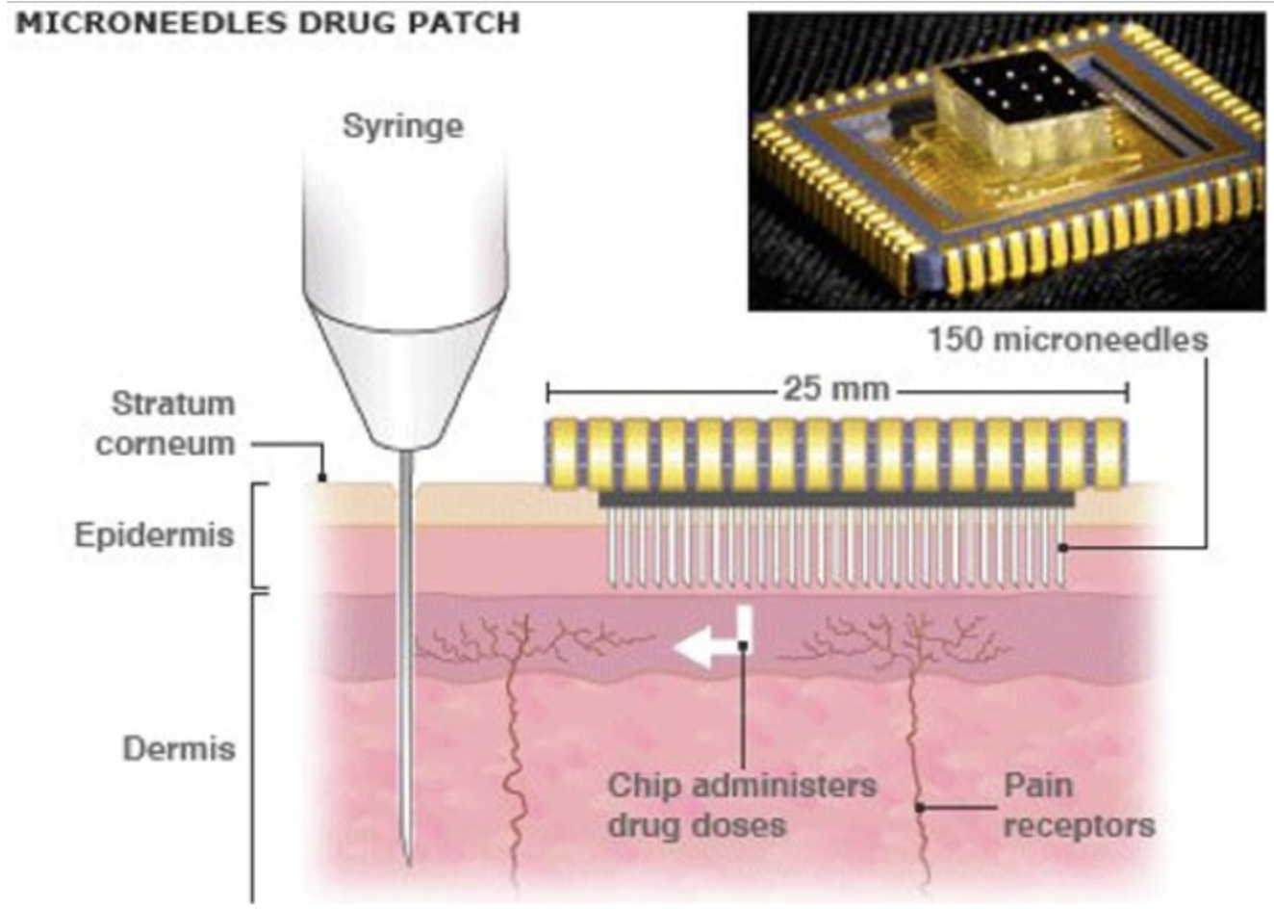
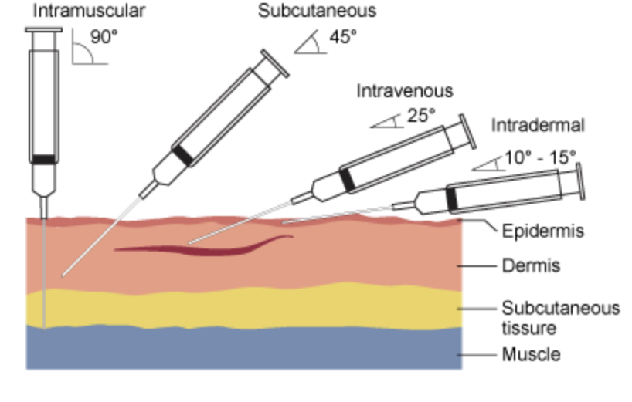
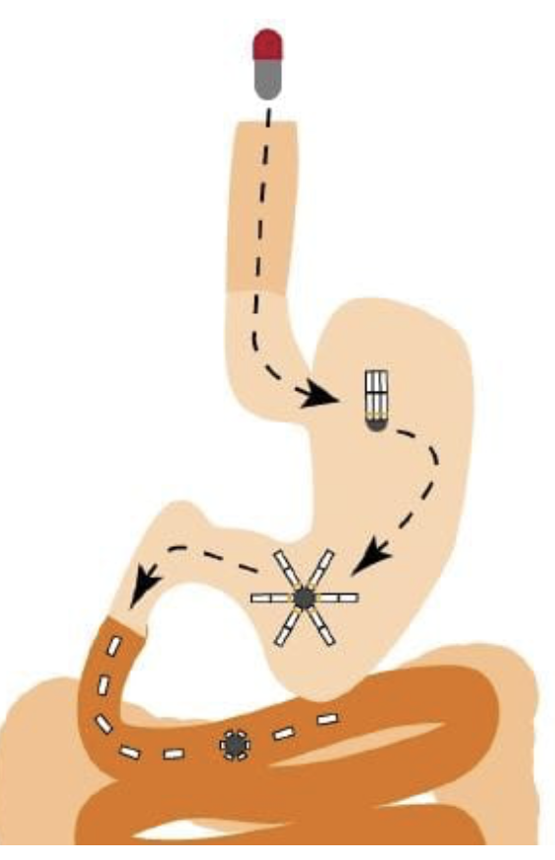
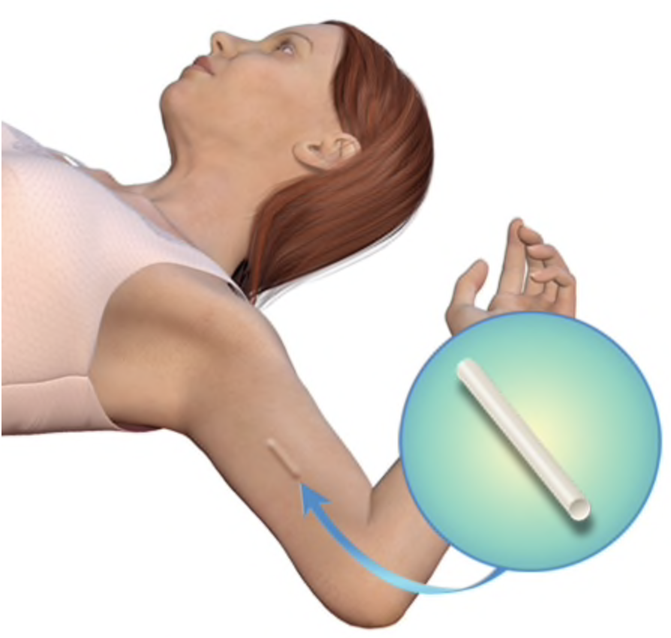
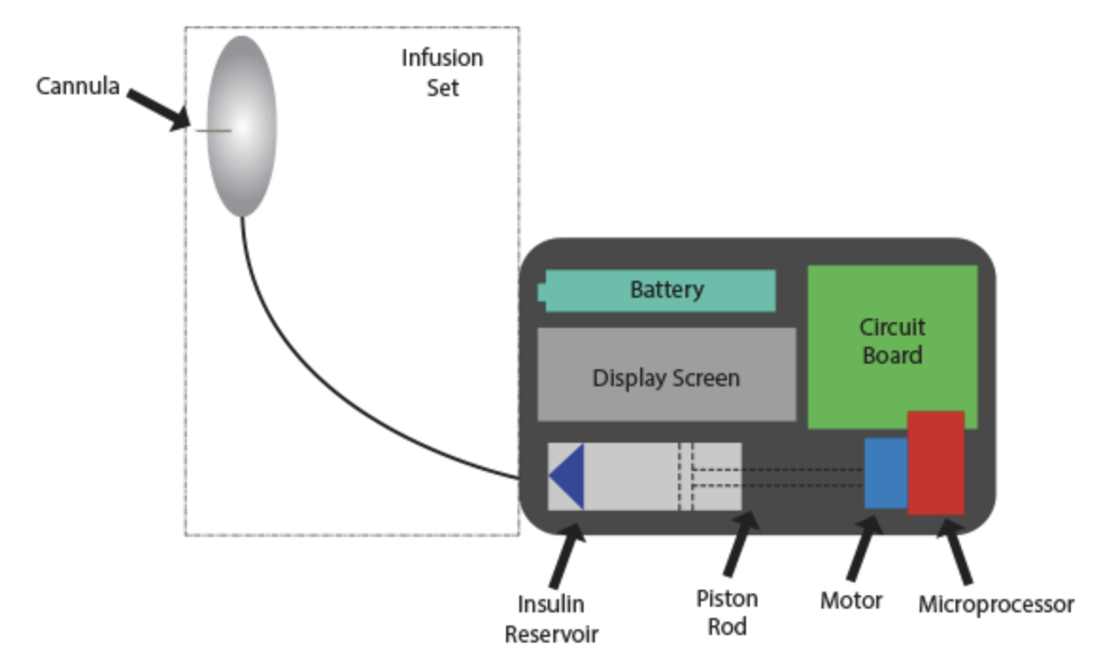
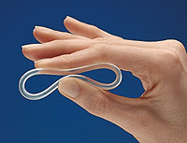
Technology for Drug Delivery
Long-acting depot injections
Microneedle drug patch
New drug delivery systems:
The promise of long-acting ART
Subdermal implant
Novel oral formulations
Wearable infusion pump
Vaginal rings

Slide 3
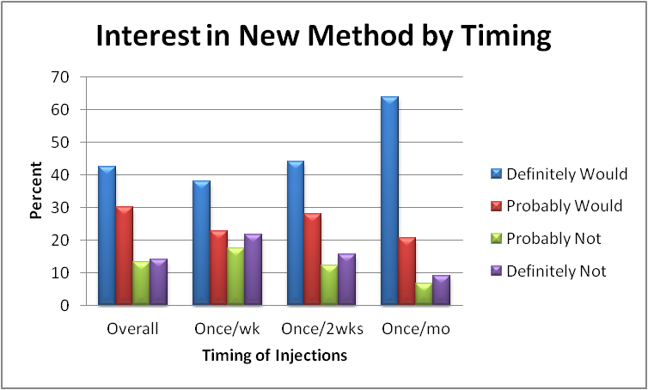
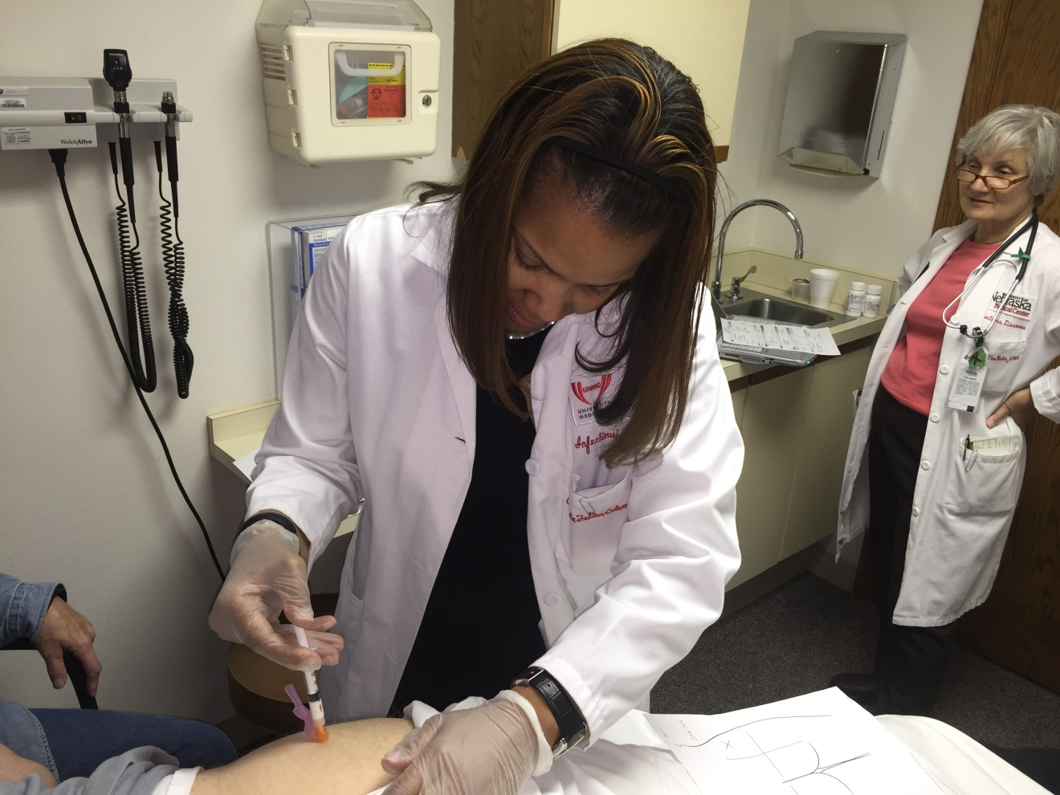
Williams et al Nanomedicine 2012
LATTE 2 Study Drug Administration

Slide 4
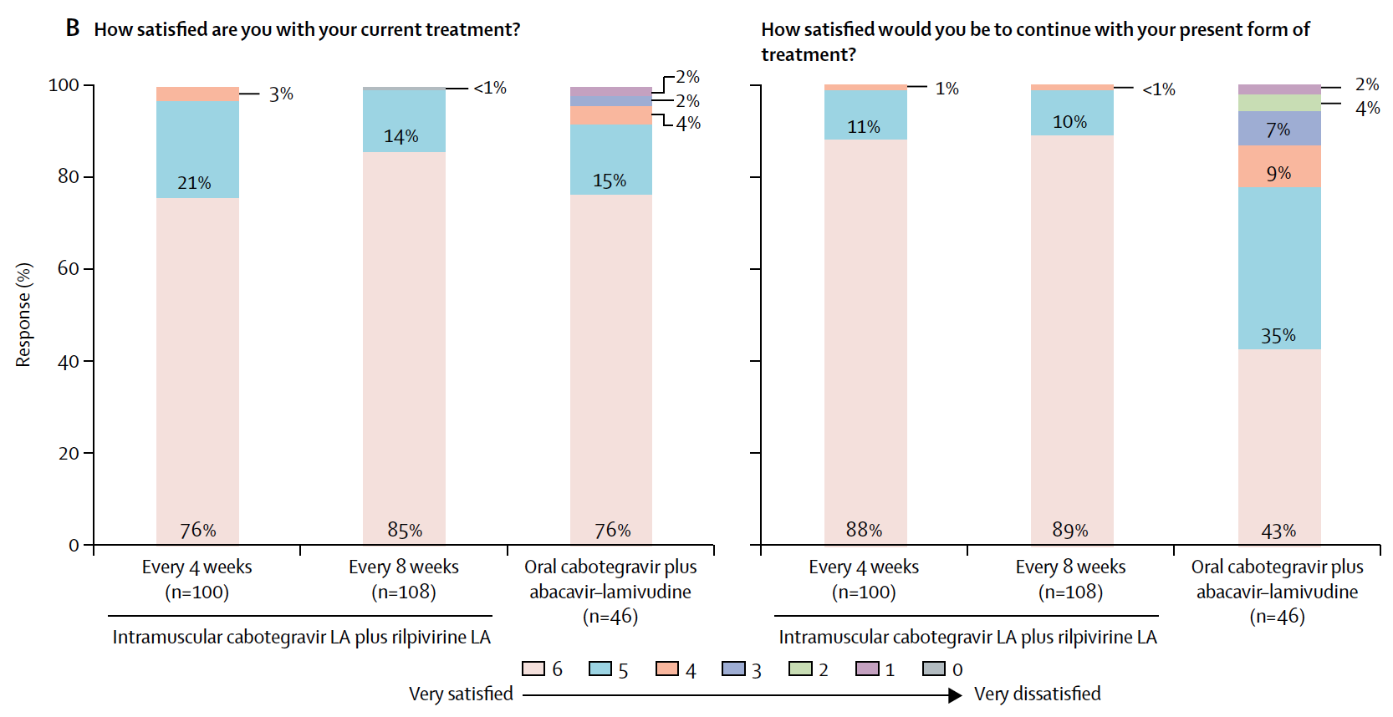
Long-acting Cabotegravir and Rilpivirine for Maintenance Therapy
Margolis DA, et al. Lancet 2017.

Slide 5
Characteristics of Successful
Long-Acting Agents
Most developed from oral formulations
  Low oral dose
  Medium to long half life
  Therapeutic concentrations must be low
Drug development strategies to improve these characteristics: nanoformulations; prodrugs; devices
 | Daily oral dose | Half life | Therapeutic concentration
DMPA | 10 mg | 17 h | pg to ng range
Risperidone | 3 mg | 20 h | 1 -5 μg/mL
Cabotegravir | 50 mg | 14 h | 1.5 μg/mL
Rilpivirine | 25 mg | 50 h | 100 ng/mL

Slide 6
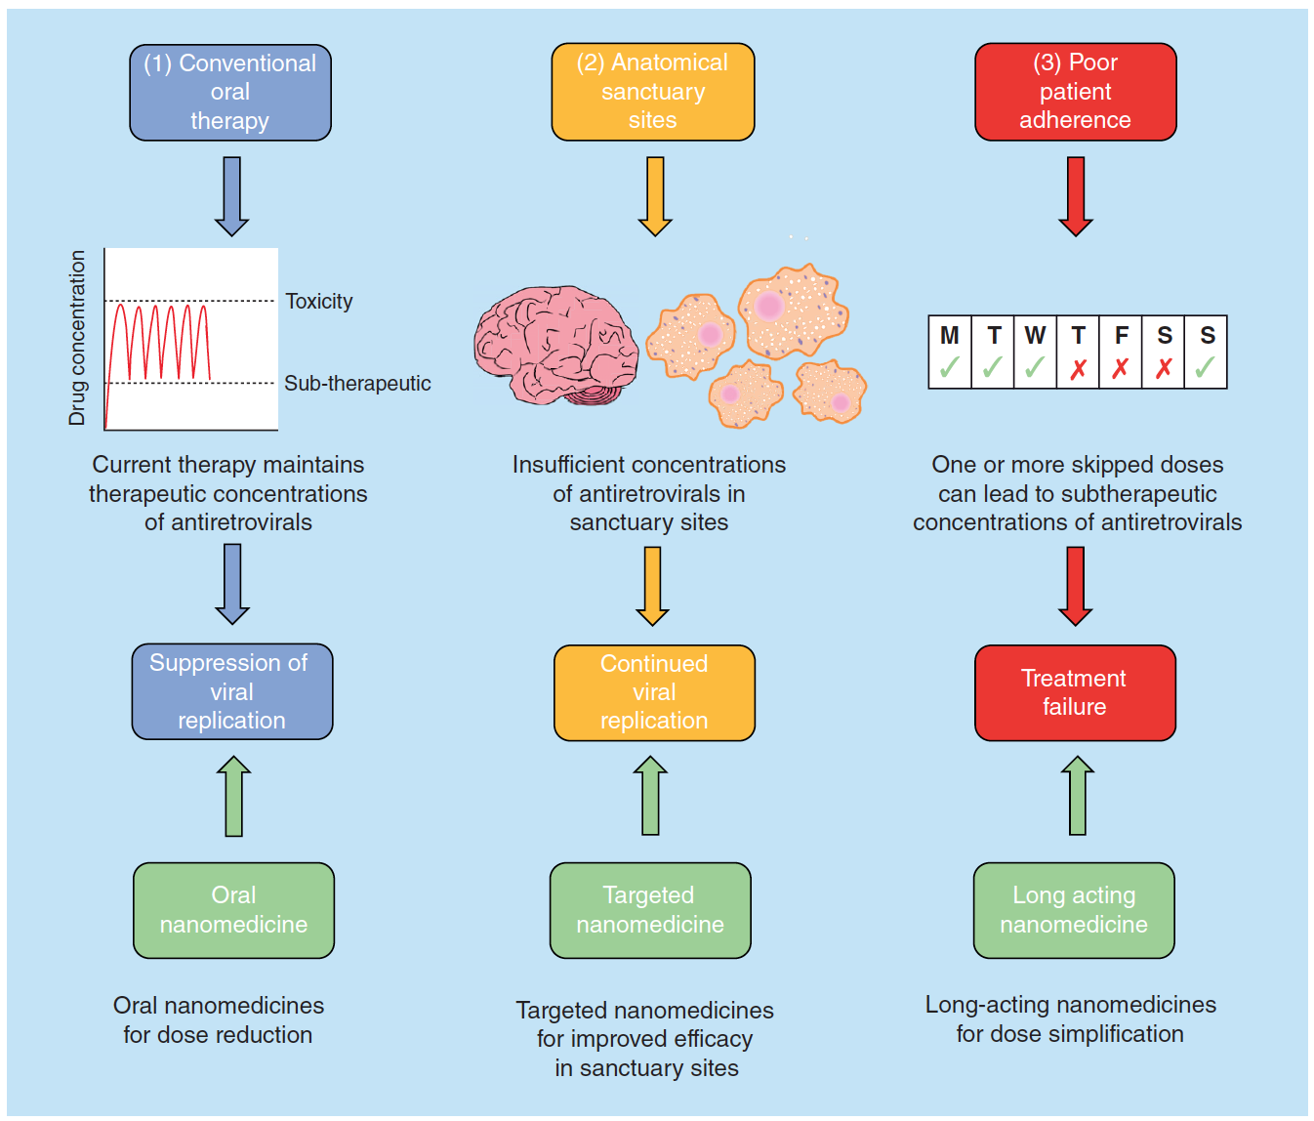
Nanomedicine Applications for HIV Therapy
Curley P et al. Future Science OA, 2018.

Slide 7
Drug delivery systems:
Long-Acting Injectables

Slide 8
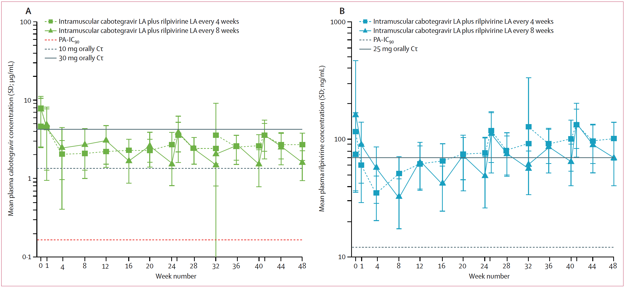
Cabotegravir and Rilpivirine Concentrations with Parenteral Administration of
Long-Acting Nanosuspension
Margolis DA, et al. Lancet 2017;390:1499-1510.

Slide 9
Long-acting injectables work – now what?
What about children, adolescents, pregnant women?
Oral lead in – what, how long, can it be eliminated?
What is the optimal LA dose and frequency?
Can injection volumes be reduced?
How do you manage toxicities and drug-drug interactions, short-term and long term?
How do you manage missed doses?
How do you stop therapy?
How do you manage the long drug exposure after the last dose (PK tail)?
Slide Courtesy of Courtney V. Fletcher.

Slide 10
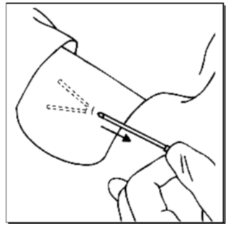
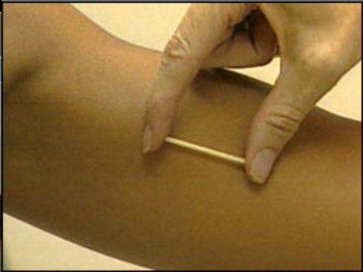
Drug Delivery systems:
Implantable devices

Slide 11
Example in contraception:
Levonorgestrel Concentration-Time Curve

Slide 12
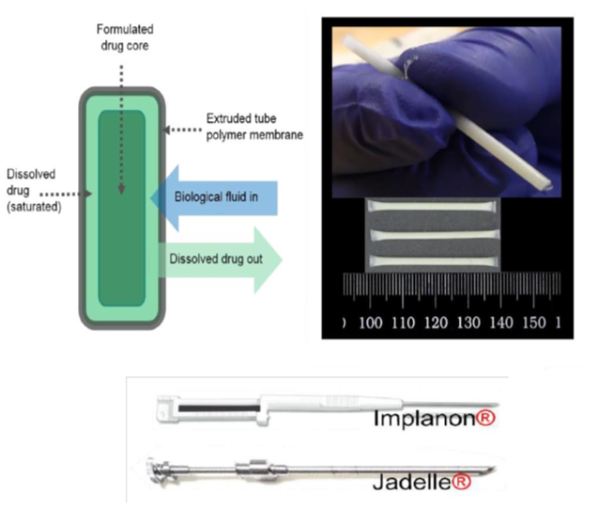
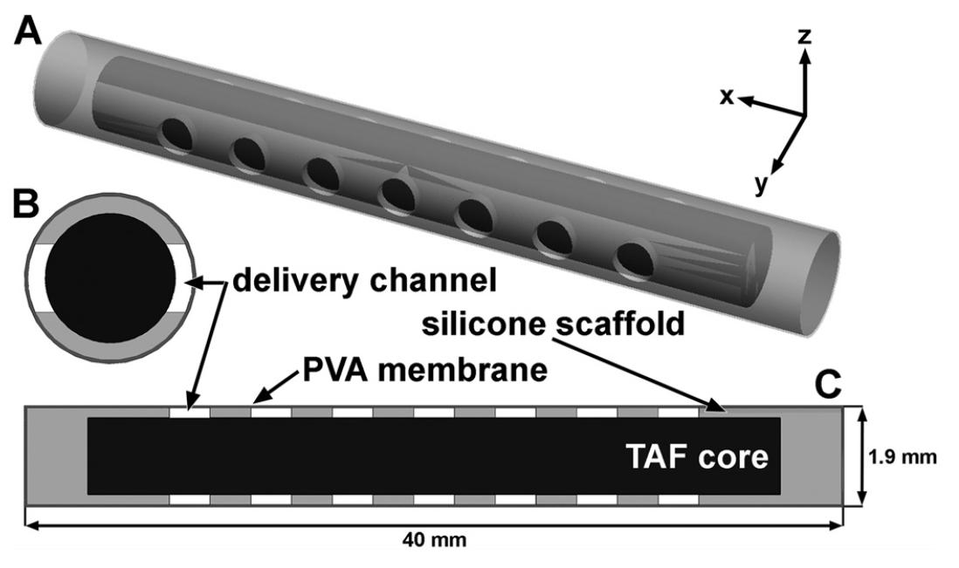
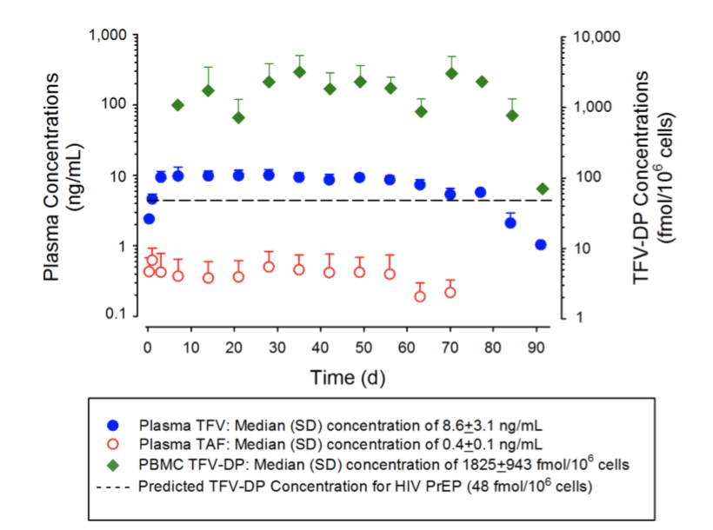
Long-Acting TAF Subdermal Implant
Tissue penetration declined over 90 days.
Authors acknowledge further work is required to address this.
Gatto, et al. CROI 2018. Abstract 486
Gunawardana M, et al. AAC 2015.

Slide 13
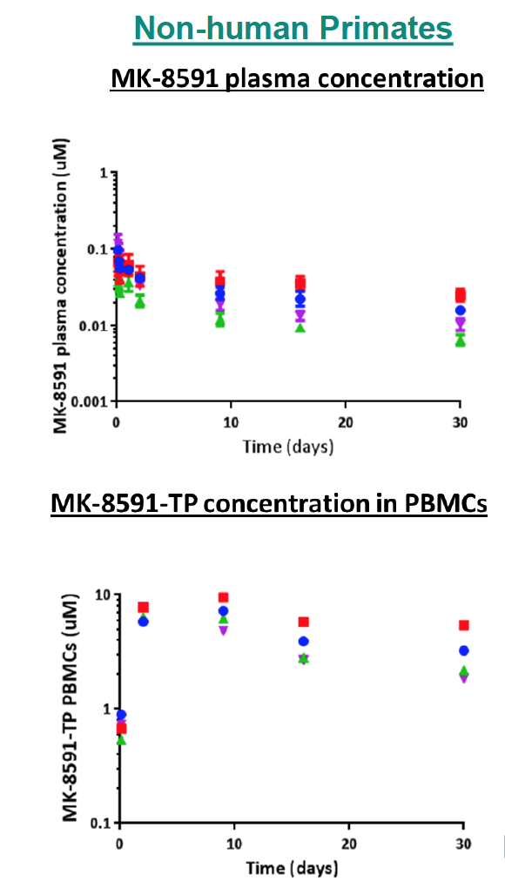
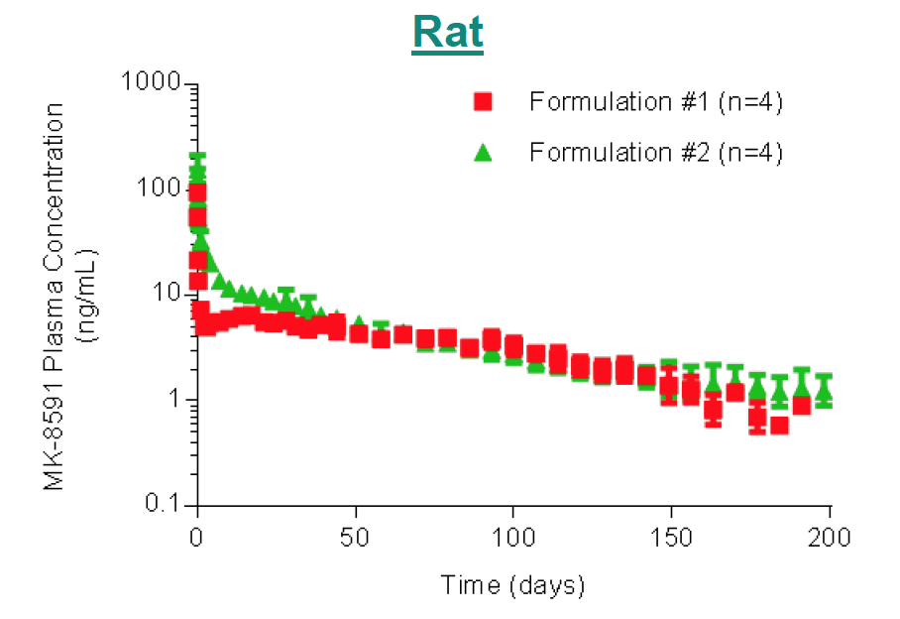
MK-8591 Shows Prolonged Release After Parenteral Administration
> 180 day release from a solid formulation after single injection in the rat.
Ongoing non-human primate study suggests implants can deliver sustained therapeutic concentrations.
Gobler et al. HIV&Hep PK conference. 2016.

Slide 14
Implant advantages and disadvantages
Advantages
Removable at end of treatment and for adverse effects
Potential provide therapy for years with a single insertion
  Inert, non-degradable options available or biodegradable options in development
Potentially improved and more stable pharmacokinetics
Palpable under skin indicates receipt of drug
Disadvantages
Minor sterile medical procedure required for insertion (and removal)
Palpation will not determine duration of use
Complicated regulatory environment
Flexner C. Curr Opin HIV AIDS 2018.

Slide 15
Drug delivery systems:
Long-Acting Oral products

Slide 16
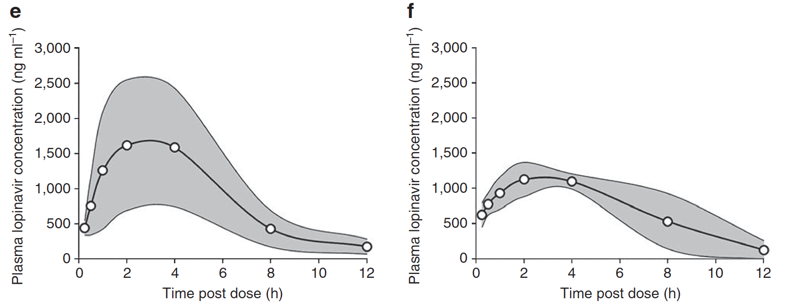
Lopinavir/Ritonavir Oral Nanoformulation without Alcohol
Plasma LPV concentrations when LPV/RTV (4:1 ratio) given orally in the conventional vs. spray-dried nanoparticle formulation to rats.
Giardiello M et al. Nature Communications 2016

Slide 17
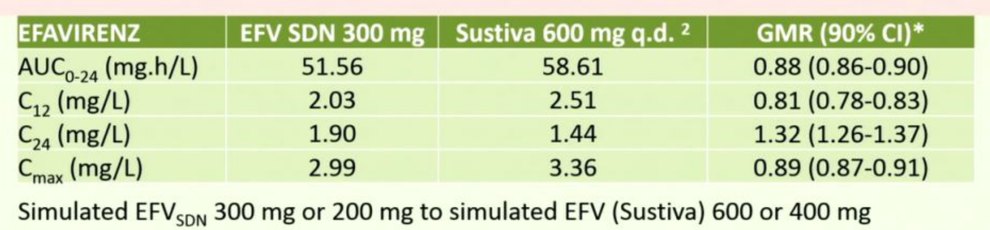
Efavirenz Solid Nanoparticle with Enhanced Oral Bioavailability
EFV 300 mg solid drug nanoparticle comparted with the conventional 600 mg EFV dose in healthy volunteers.
Pharmacokinetics were similar or higher with the nanoparticle.
Potential to achieve therapeutic equivalence with a 50% dose reduction = significant cost savings
Owen A. CROI 2017. Abstract 39.

Slide 18
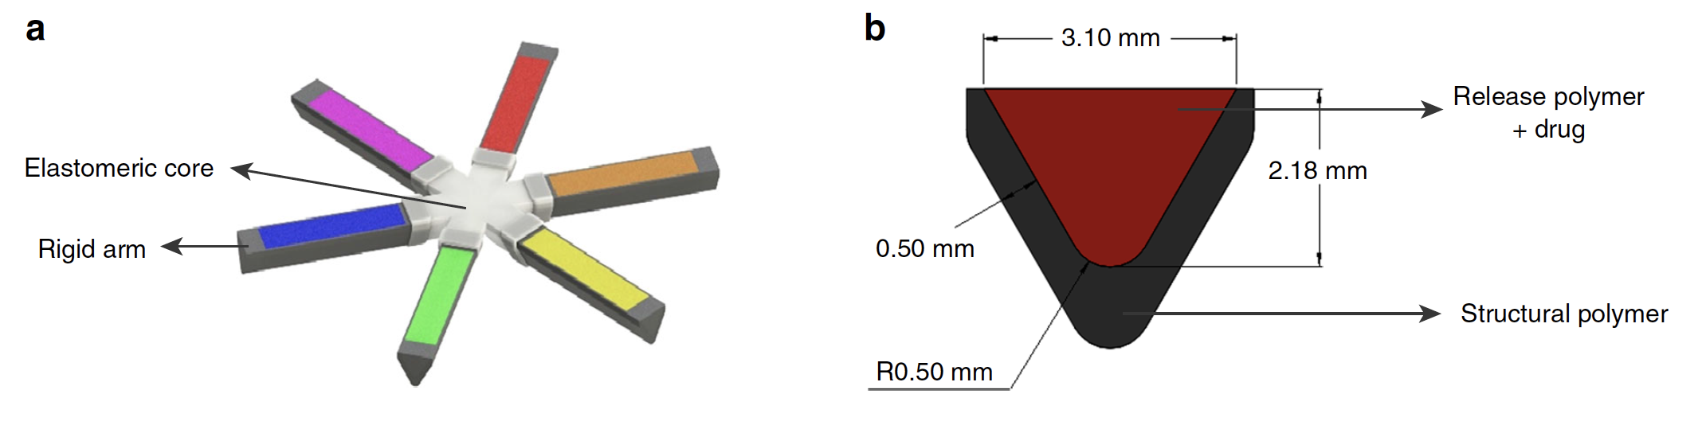
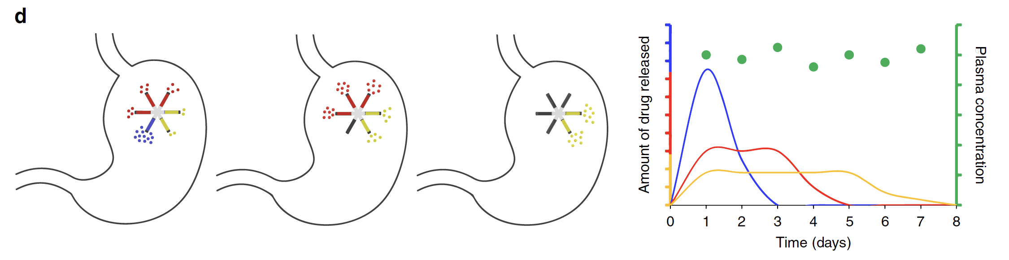
Antiretroviral Oral Drug Sustained Release Delivery System
Kirtane A, et al. Nature Communications 2018.

Slide 19
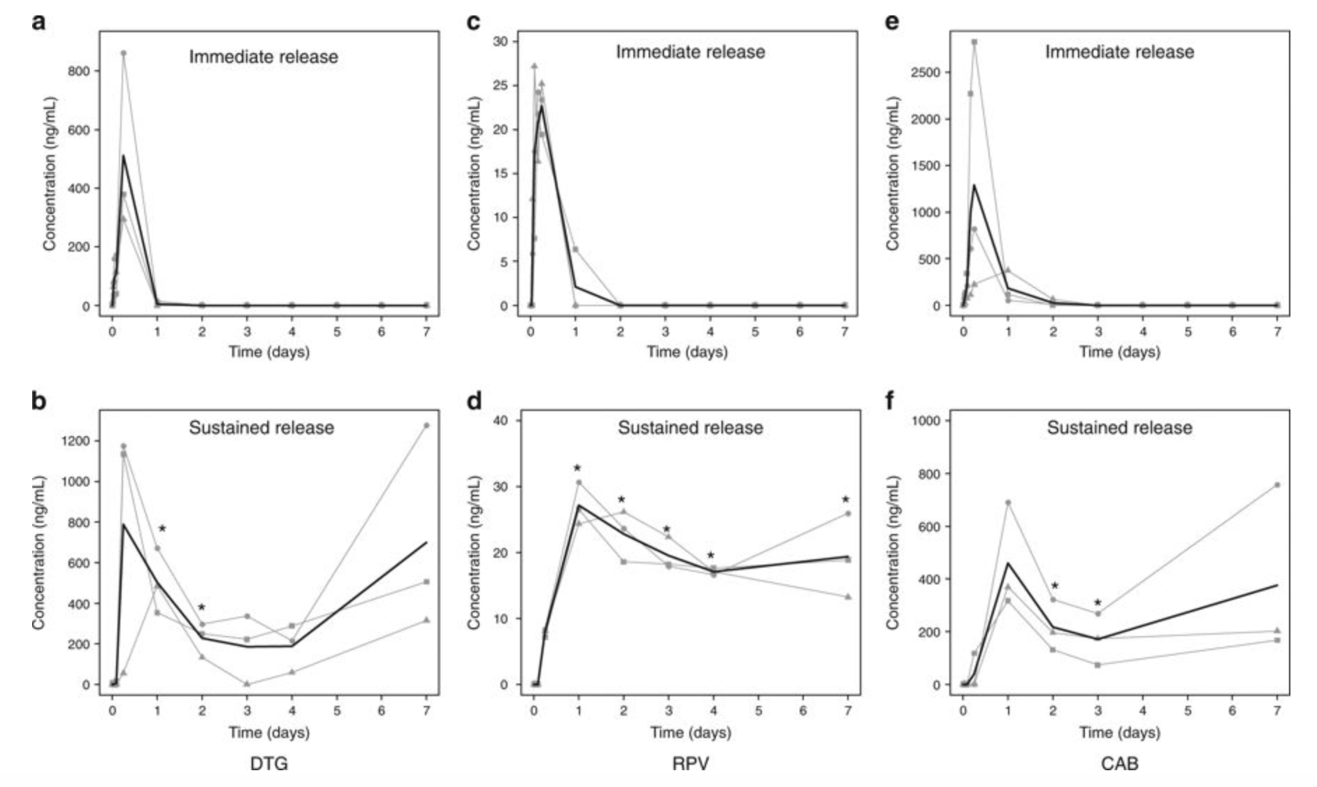
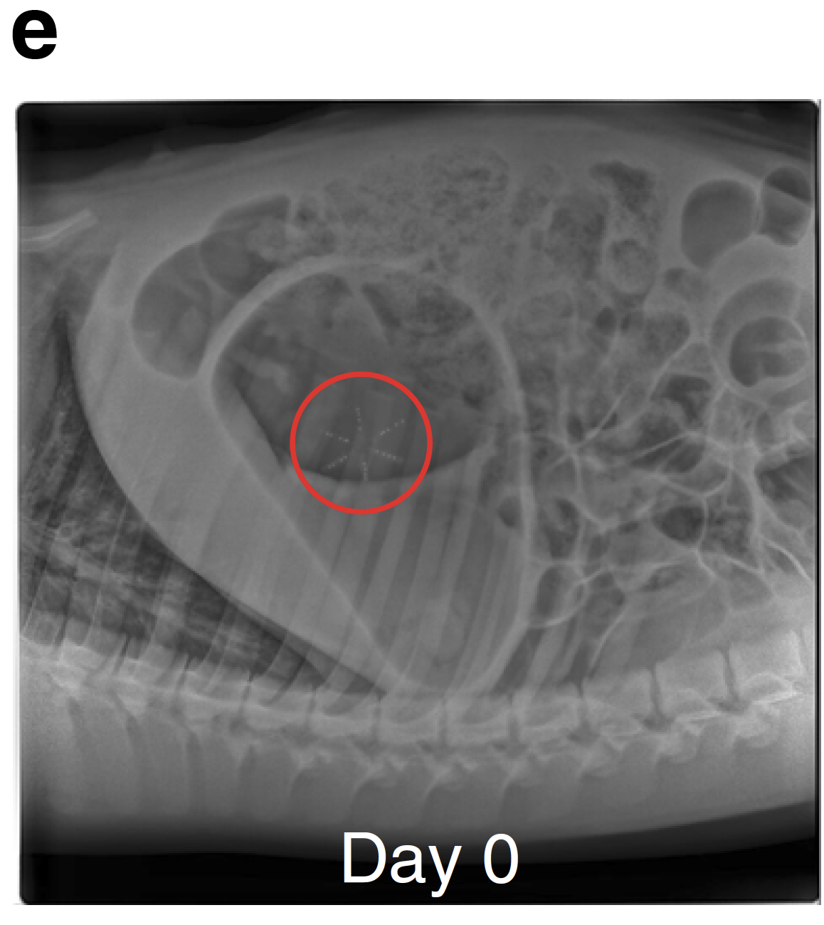
Antiretroviral Oral Drug Delivery System: application in a swine model
Kirtane A, et al. Nature Communications 2018.

Slide 20
Drug delivery system:
Vaginal rings

Slide 21
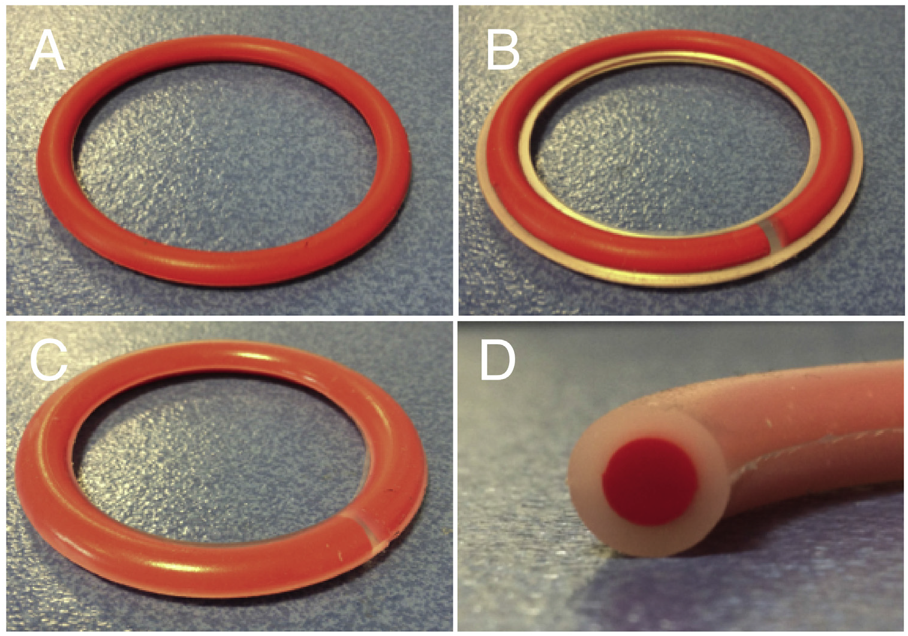
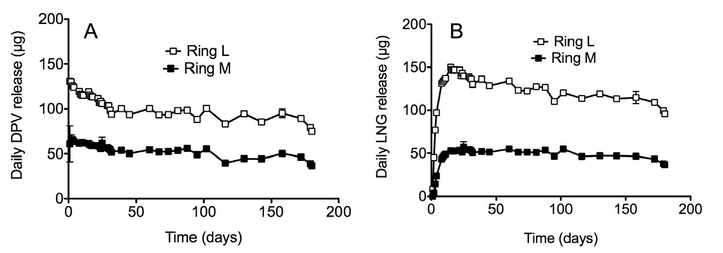
Multi-Purpose Vaginal Rings: prevention of HIV and contraception
Boyd P, et al. Intl J Pharmaceutics 2016;511:619-29.

Slide 22
Novel ARV Drug Delivery: needs and some opportunities to improve patient care
Long acting fixed dose combinations
  Combination products to achieve sustained drug delivery
New drugs
  Highly potent, selective agents with novel mechanisms of action and additive-to-synergistic with existing agents
Targeted delivery
  To achieve improved tissue/organ distribution such as to brain and lymphoid tissues (C_{t} or C_{c} = C_{p})
Pediatric formulations
  New formulations and combinations
Slide adapted with permission from Courtney V. Fletcher.

Slide 23
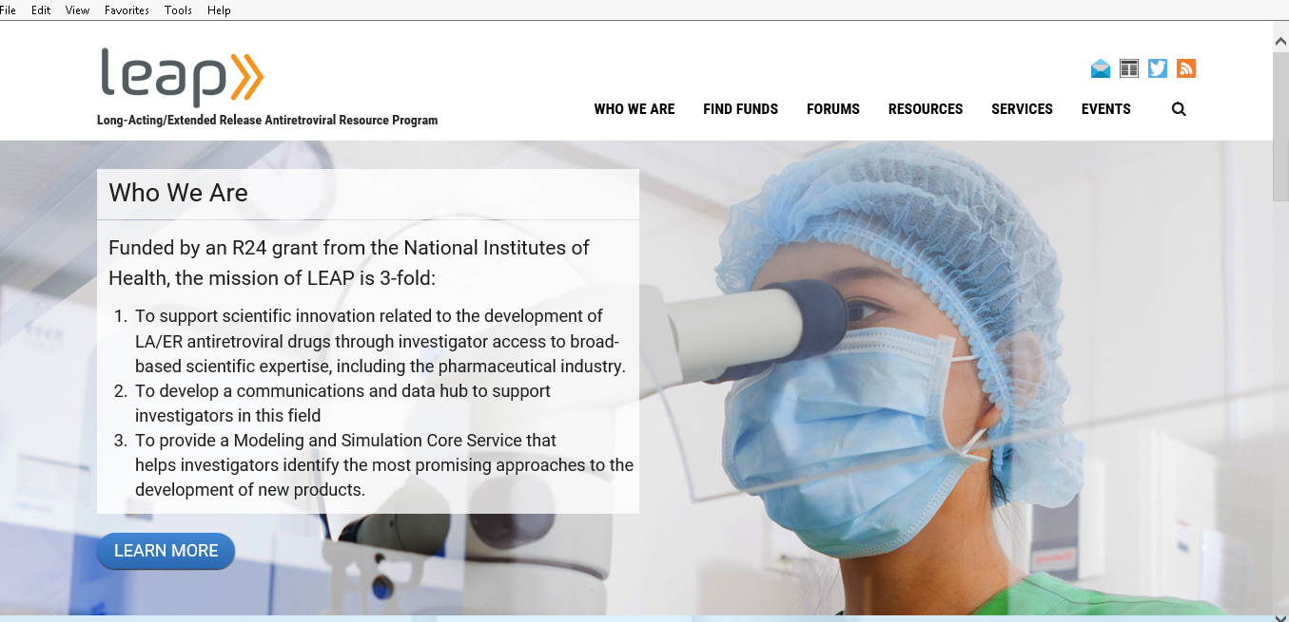
Emerging information on long acting formulations: www.leapresources.org
My thanks to Sue Swindells and Courtney Fletcher for mentorship and sharing slides.
Special thanks to those living with HIV who support and advocate for this work. Our fight against HIV and AIDS is indebted to people living with HIV, both past and present.

